Slide 1
Making the ‘invisible’ sub-microscopic world of Chemistry ‘visible’
Dr Katherine Putnam

Slide 2

Conceptual understanding of chemistry
The inability of students to visualise the sub-microscopic nature of matter represents an obstacle for the development of students’ conceptual understanding

Slide 3

Negotiating meaning
  Why do we get students to conduct experiments?
      Develop Key science skills
      Students love them
      Teachers love them
      Engaging
      Break the conceptual barrier
        Providing students with an opportunity to obtain experimental evidence to rationalise thinking about the underlying chemical concept
PROS | CONS
Students love them | Risk of being ‘hands-on without being minds-on’
Engaging | Student conceptual understanding not clear

Slide 4

Make student thinking visible
Pair experiments with modelling of the sub-atomic level
      Facilitate conceptual understanding by making the sub-microscopic world ‘visible’
        Students correlate the ‘visible’ macroscopic phenomenon with the ‘invisible’ sub-microscopic world through modelling at the molecular level
      Make student thinking visible
        Helps address misconceptions
      ‘Minds-on’ as well as ‘hands-on’
        Students learn more from reflecting on experiences that the experiences themselves
      Develop critical thinking

Slide 5
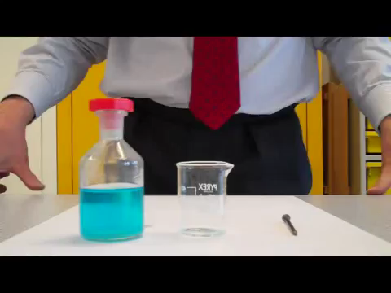
Metal magician
https://www.youtube.com/watch?v=KmhD8BmEFIo

Slide 6
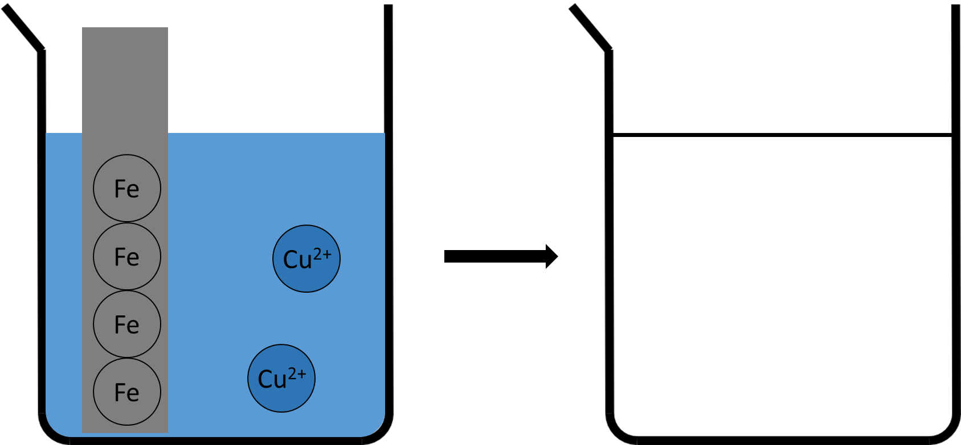
Metal magician

Slide 7
Solution detective

Slide 8
Gas laws

Slide 9

Improving existing experiments
  Transforming current activities/experiments
      Develop critical thinking
      Include modelling

